Slide 1

Razor Pages & Dependency Injection
Robert Rozas Navarro
Premier Field Engineer
Apps Domain

Slide 2
Razor Pages

Slide 3
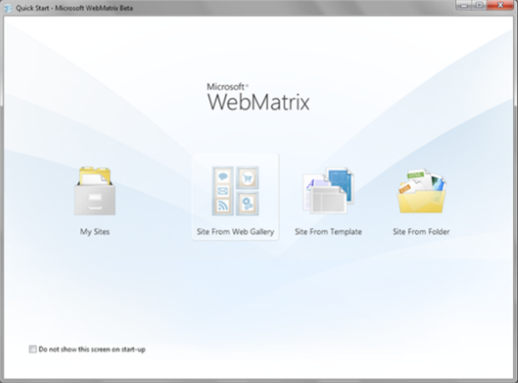
What are Razor Pages?
Razor Pages is a new feature of ASP.NET Core 2.0 that makes page-focused web
applications easy to manage and fast to develop.
The name, Razor Pages, is a callback to WebMatrix and ASP.NET Web Pages, which was
based on MVC3 that allowed server-side code within HTML pages

Slide 4
What are Razor Pages? (cont…)
Razor Pages are optimized for anything browser related, especially GET/POST/REDIRECT
workflows.
Razor Pages are NOT a replacement for MVC; Razor Pages are actually built on top of MVC

Slide 5
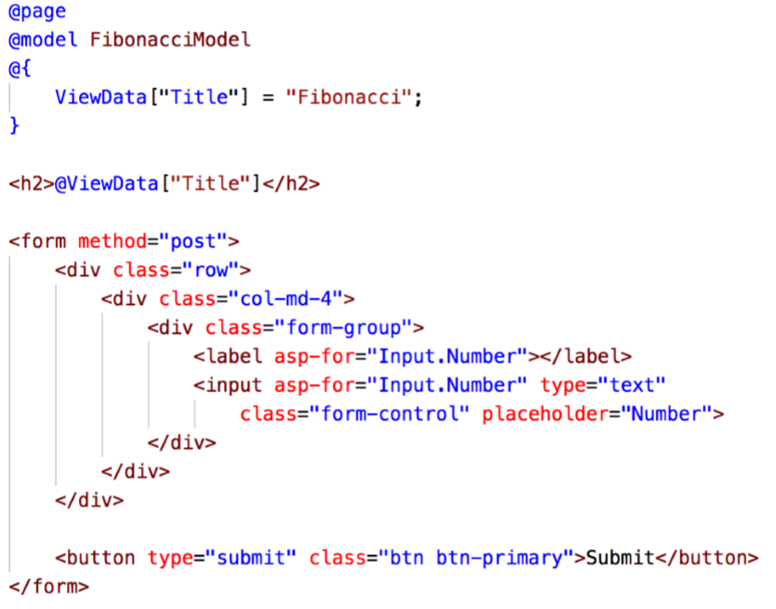
The Basics of Razor Pages.

Slide 6
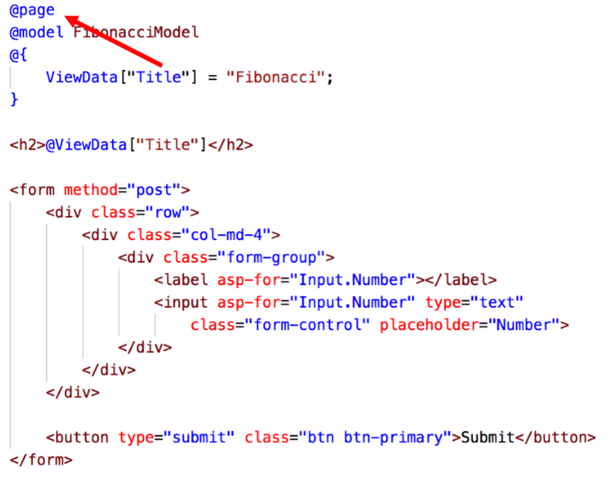
The Basics of Razor Pages (cont…)

Slide 7
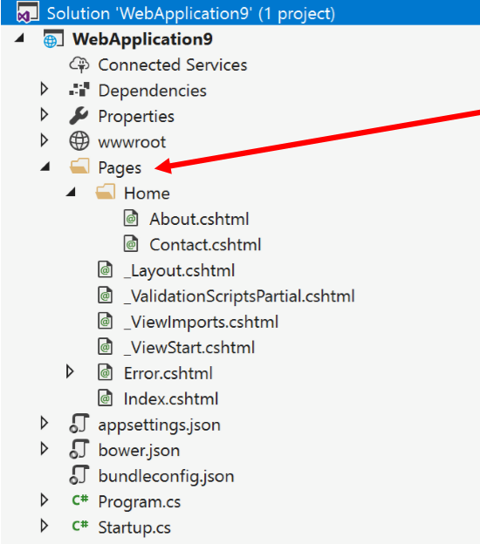
The Basics of Razor Pages (cont…)
Where are the folders for controllers, views, and models?

Slide 8
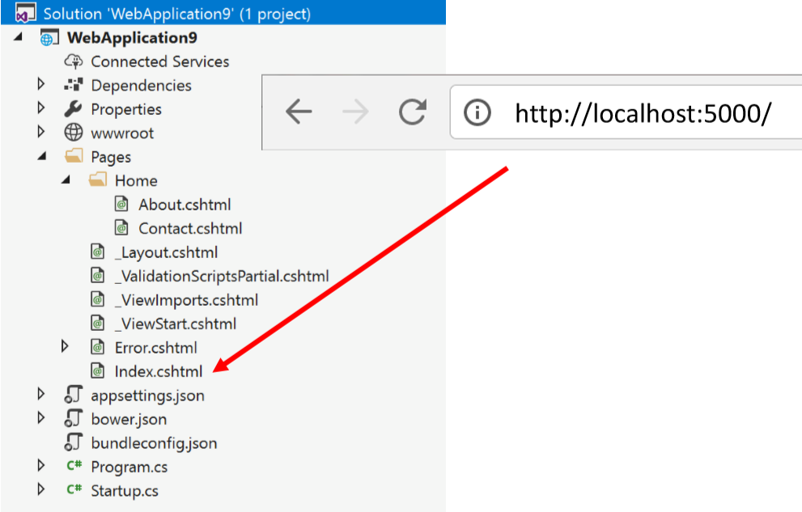
The Basics of Razor Pages (cont…)

Slide 9
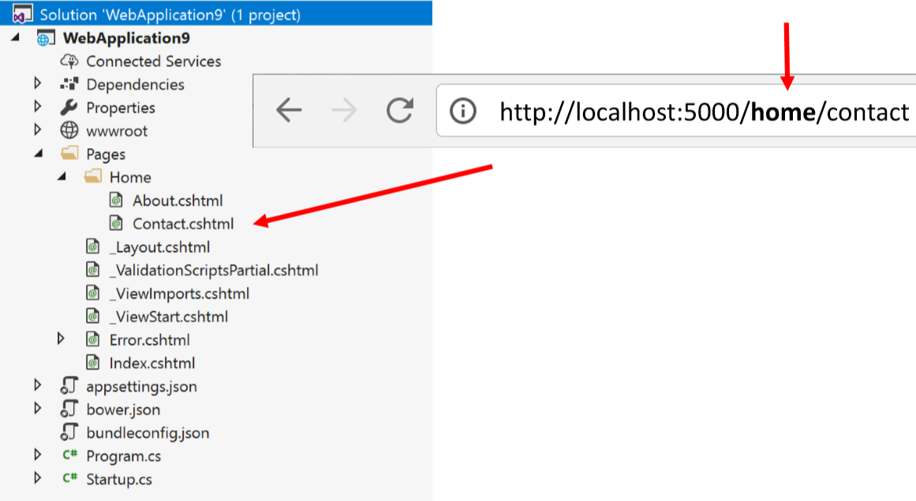
The Basics of Razor Pages (cont…)

Slide 10
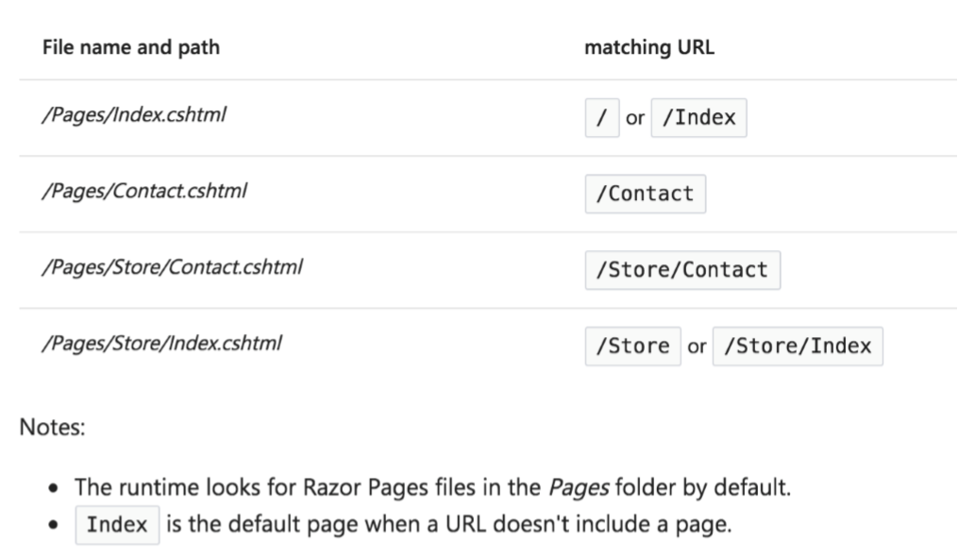
The Basics of Razor Pages (cont…)

Slide 11
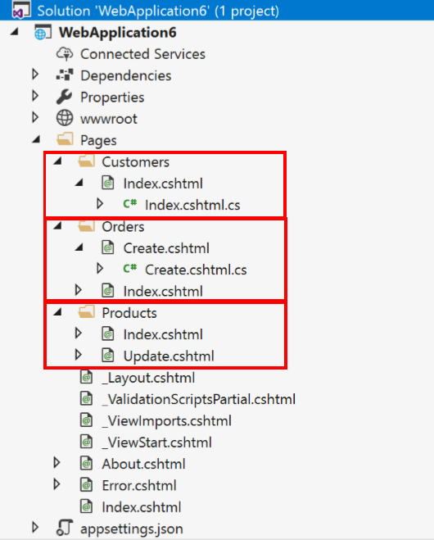
The Basics of Razor Pages (cont…)
Feature Folders are apart of Razor Pages!

Slide 12
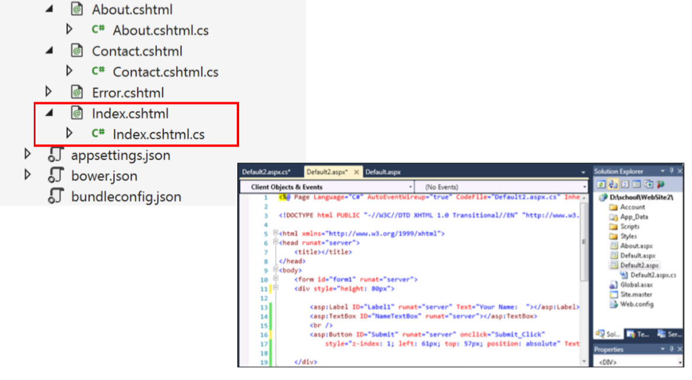
The Basics of Razor Pages (cont…)

Slide 13
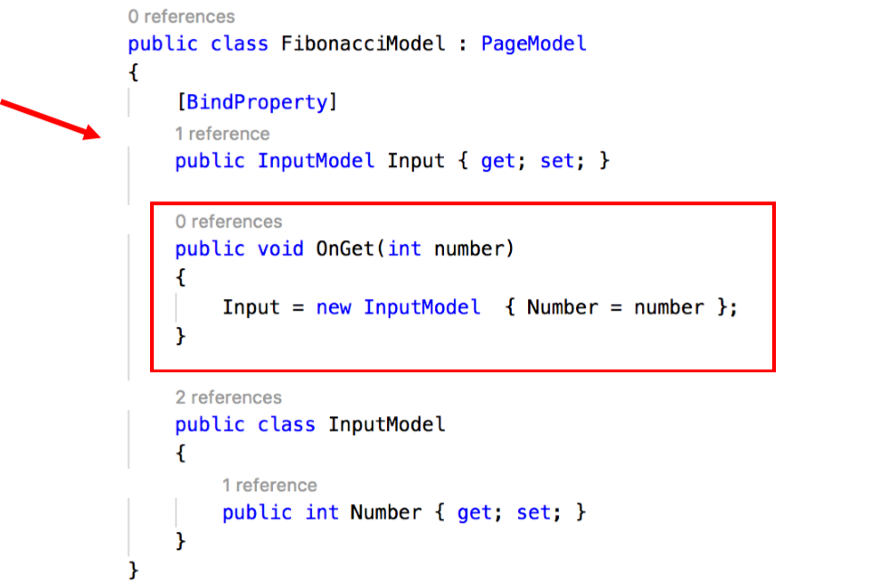
The Basics of Razor Pages (cont…)

Slide 14
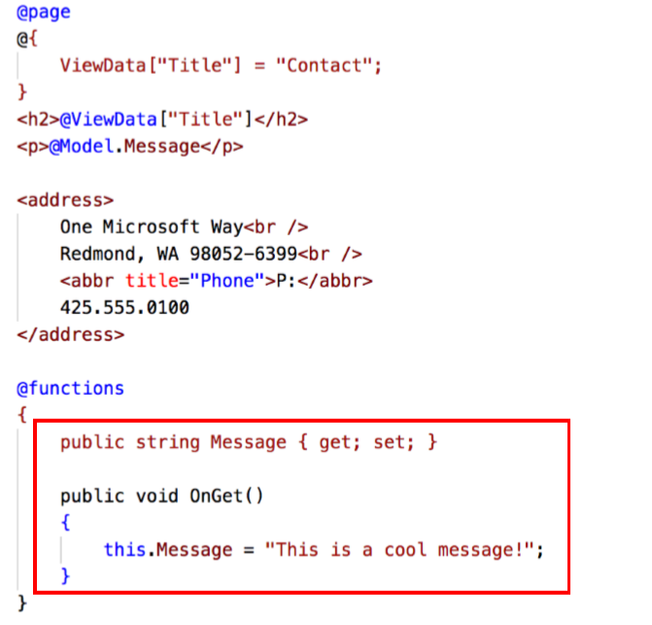
The Basics of Razor Pages (cont…)

Slide 15
The Basics of Razor Pages (cont…)

Slide 16
Bonus, Deep Dive https://www.learnrazorpages.com/ Razor Pages Practice Lab, Click on VS Tutorial 1 and follow the instructions https://github.com/AshWilliams/aspnetcore-for-beginners

Slide 17
Demo Razor Pages

Slide 18
Dependency Injection

Slide 19
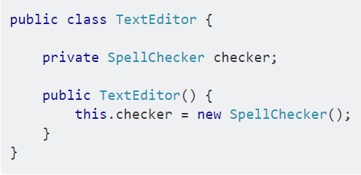
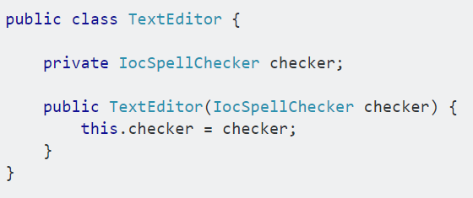
IoC and Dependency Injection
The Inversion of Control (IoC) and Dependency Injection (DI) patterns are all about removing dependencies from your code.
Notes:
In the first code example we are instantiating SpellChecker (this.checker = new SpellChecker();), which means the TextEditor class directly depends on the SpellChecker class.
In the second code example we are creating an abstraction by having the SpellChecker dependency class in TextEditor constructor signature (not initializing dependency in class). This allows us to call the dependency then pass it to the TextEditor class like so:

Slide 20
IoC and Dependency Injection(cont…)
IoC (Inversion of Control) is an abstract concept. It means objects do not create dependent objects directly, it gets from outside of the object scope.
There are several basic techniques to implement inversion of control.
Using a factory pattern
Using a service locator pattern
Using Dependency Injection(DI), for example:
Constructor injection
Parameter injection
Setter injection
Etc.

Slide 21
Built In Dependency Injection
Service lifetime
There are 3 options for this with the built-in DI container in ASP.NET Core:
Singleton
Scoped
Transient
Notes:
Dependency Injection is a technical mechanism that allows providing dependencies needed by an object, instead of having it construct them itself.
Singleton means only a single instance will ever be created. That instance is shared between all components that require it. The same instance is thus used always.
Scoped means an instance is created once per scope. A scope is created on every request to the application, thus any components registered as Scoped will be created once per request.
Transient components are created every time they are requested and are never shared.

Slide 22
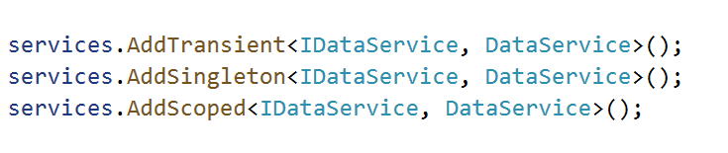
Built In Dependency Injection
Service Registration
Registering services is done in the ConfigureServices(IServiceCollection) method in your Startup class.
Notes:
Dependency Injection is a technical mechanism that allows providing dependencies needed by an object, instead of having it construct them itself.
Singleton means only a single instance will ever be created. That instance is shared between all components that require it. The same instance is thus used always.
Scoped means an instance is created once per scope. A scope is created on every request to the application, thus any components registered as Scoped will be created once per request.
Transient components are created every time they are requested and are never shared.

Slide 23
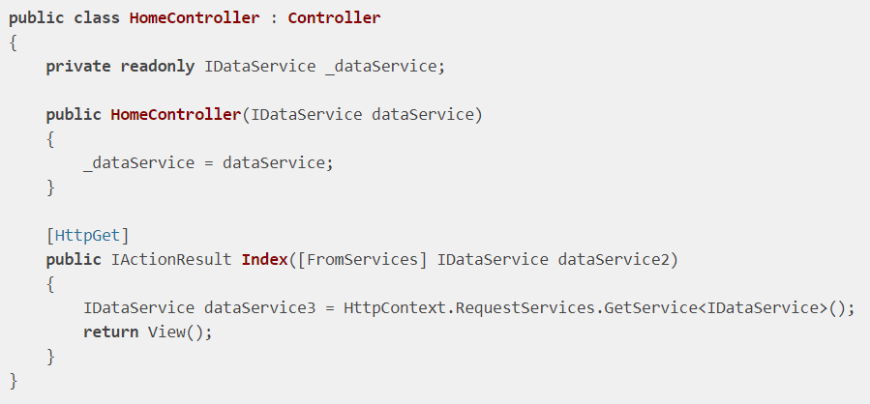
Injection in MVC Core
The most common way for doing dependency injection in MVC is constructor injection.
You can do that pretty much anywhere. In controllers you have a few options:

Slide 24

Injection in Razon Views
You can also inject components in Razor views with the new @inject keyword:
You should not abuse this mechanism to bring data to views that should come from the controller.

Slide 25
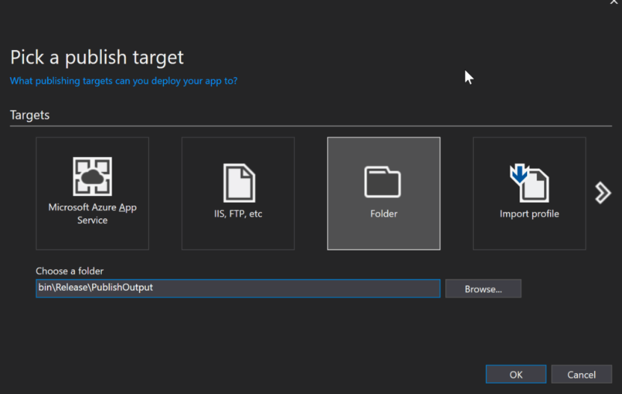
Bonus, How to Deploy ASP.NET Core to IIS & How ASP.NET Core Hosting Works https://stackify.com/how-to-deploy-asp-net-core-to-iis/

Slide 26
Demo DI

